Slide 1
Lead Scoring Case Study
Presented by,
Vishal Batra,
Prashanth Reddy,
Hemalatha H

Slide 2
Lead Score Case Study for X Education
Problem Statement:
X-Education is an education company sells online Education courses to professionals and marketing through online advertisements.
Company gets information through different channels and if candidates enquiring with certain education level it calls lead.
Typically lead conversion is 30% of certain education. Company identifying Hot Leads on certain criteria also.
Lead conversion ratio is lesser than number of enrollment. Company given Target to achieve 80% of total enrollment.
Business Goal:
Building logistics regression model to finding leads for Company and help to achieve potential targets.
Alternative approach should be ready in case Company's requirement changes in futures should be flexible.

Slide 3
Approach
Source the data for analysis
Reading and Understanding the data
Data cleaning
Exploratory Data analysis
Data Preparation
Splitting the data into Test and Train dataset
Feature Scaling
Model Building
Model Evaluation
Plotting the ROC curve and Finding the optical cutoff
Evaluating the model by using different metrics – Specificity and Sensitivity or Precision and Recall
Making predictions

Slide 4
Problem solving methodology
1. Data sourcing, cleaning and preparation:
Read the data from CSV file
Outlier treatment
Data cleaning – Handling Null values and removing higher null values data
Removing Redundant columns in the data
Imputing Null values
Exploratory data analysis
Feature standardization
2. Feature scaling and splitting train and test sets:
Feature scaling of Numeric data
Splitting data into train and test set.

Slide 5
3. Model building:
Feature selection using RFE
Determine the optimal model using logistic regression
Calculating the model by using different metrics – Specificity and Sensitivity or Precision and Recall
4. Result or conclusion
Determine the lead score and check if target final predictions amount
Evaluating the model by using different metrics – Specificity and Sensitivity or Precision and Recall

Slide 6
Data Sourcing, Cleaning and Preparation
Read the data from CSV file
Outlier treatment
Data cleaning – Handling Null values and removing higher null values data
Removing Redundant columns in the data
Imputing Null values
Exploratory data analysis
Feature standardization
Read the data from source
Convert data into clean format suitable for anlysis
Remove duplicate data
Outlier treatment
Exploratory data analysis
Feature standardization

Slide 7
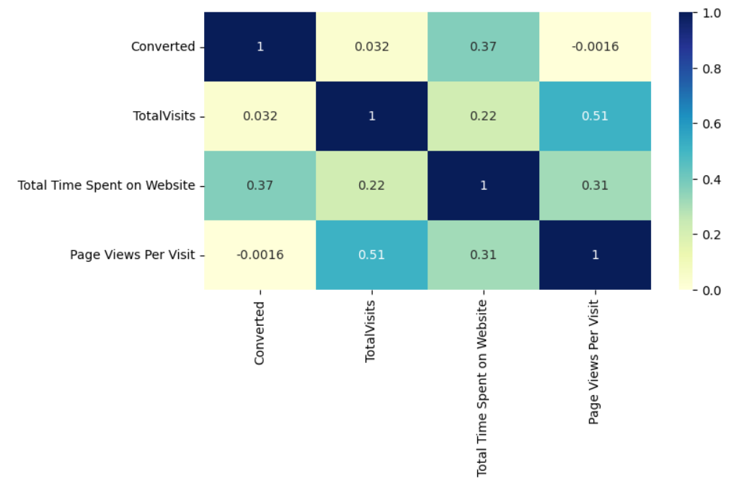
Exploratory Data Analysis
Numerical Analysis:
Checking correlations of numeric values

Slide 8
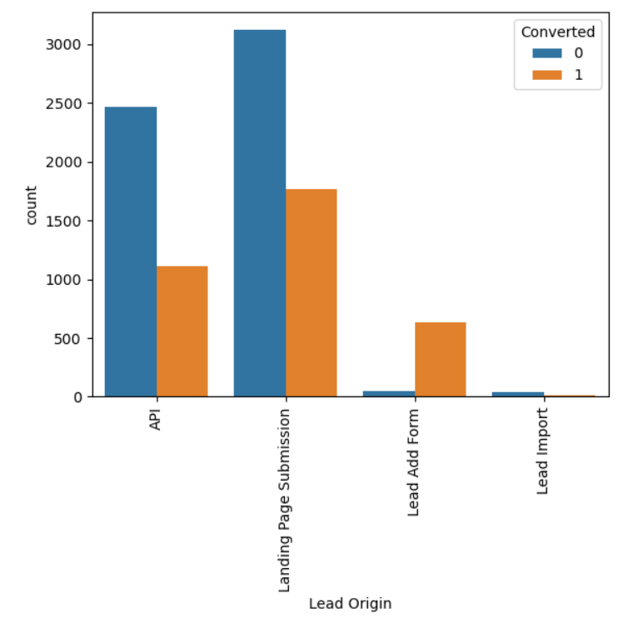
Univariate Analysis:
Plotting count plot of 'Lead Origin' for both 'Converted' 0 and 1 :

Slide 9
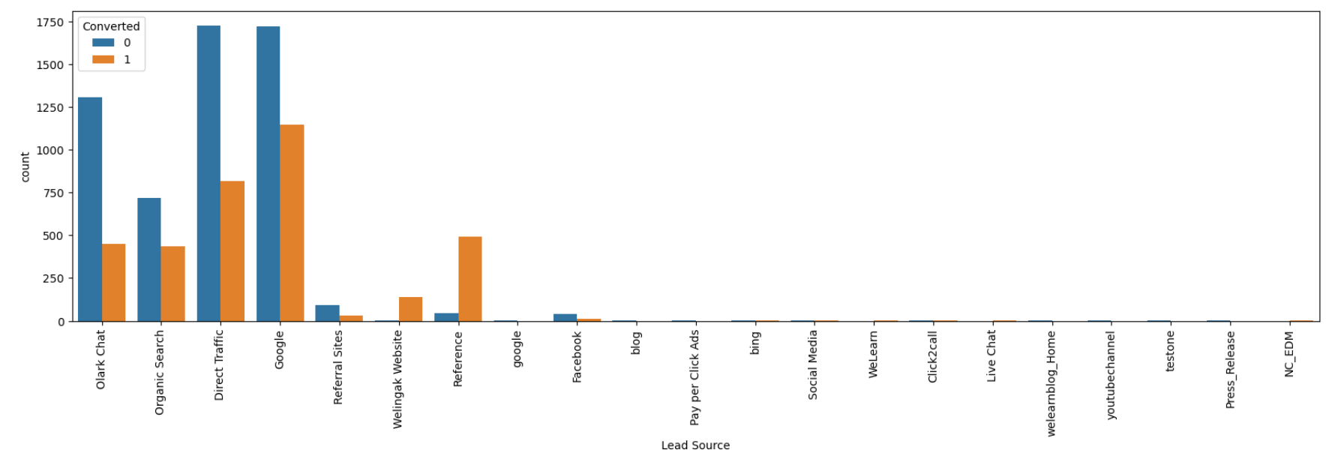
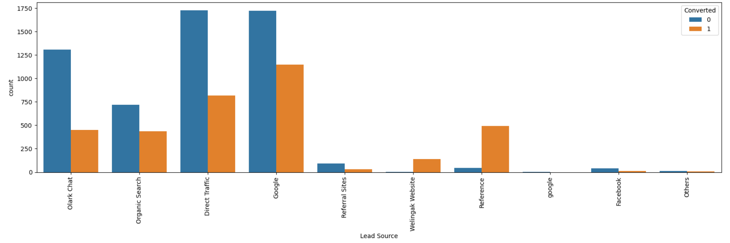
Univariate Analysis:
Plotting count plot of 'Lead Source' based on 'Converted' value 0 and 1
Again Plotting count plot of 'Lead Source' based on 'Converted' value 0 and 1

Slide 10
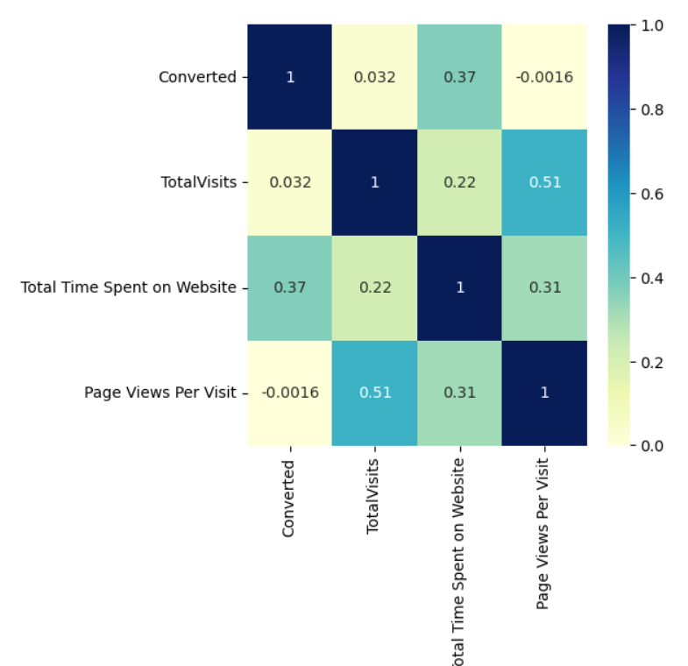
Bivariate Analysis:
Visualizing the correlation between all set of usable columns

Slide 11
Variables impacting the conversion rate
Do Not Email
Total Visits
Total Time Spent On Website
Lead Origin – Lead Page Submission
Lead Origin – Lead Add Form
Lead Source – Olark Chat
Last Source – Welingak Website
Last Activity – Email Bounced
Last Activity – Not Sure
Last Activity – SMS Sent
Current Occupation – No Information
Current Occupation – Working Professional
Last Notable Activity – Had A Phone Conversation
Last Notable Activity - Unreachable

Slide 12
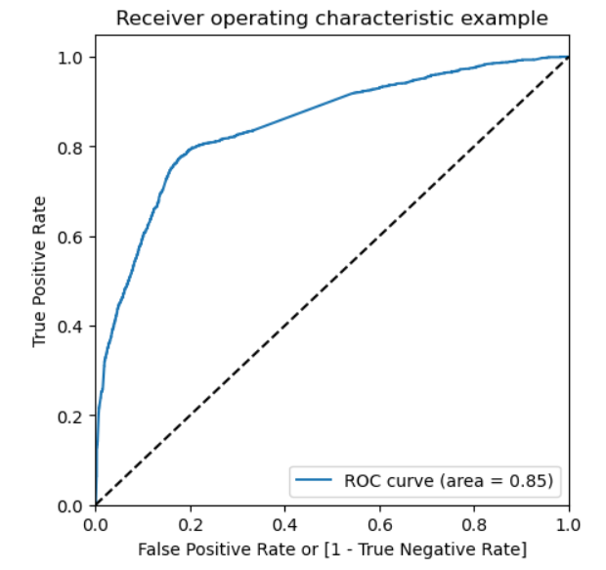
Model Evaluation
The area under the ROC curve is 0.85, which is pretty good. So it looks like we have a pretty good model. To find the cutoff, we also examine the sensitivity and the specificity of change.

Slide 13
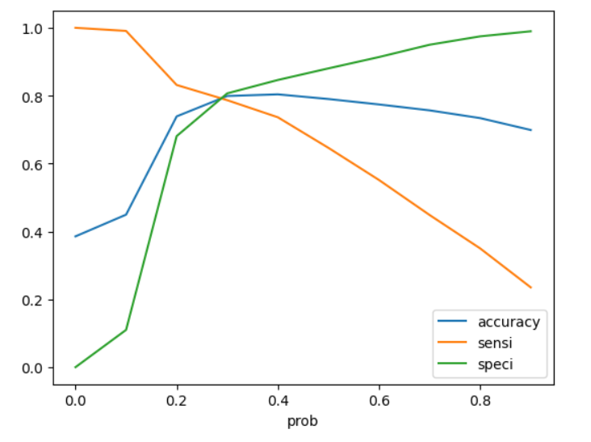
As we can see, you get the best value of the three parameters around 0.3. Now let's choose 0.3 as our breakpoint.
Confusion Matrix
3069
735
509
1877
Accuracy: 80%
Sensitivity: 78%
Specificity : 80%

Slide 14
Making Predictions
Precision and Recall View
Confusion Matrix
Confusion Matrix
1311
335
3349
455
239
769
844
1542
Sensitivity: 78%
Specificity : 80%
Precision: 77%
Recall : 64%

Slide 15
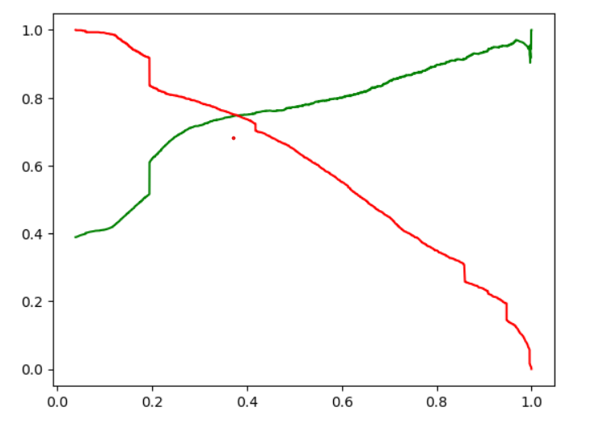
Precision and Recall tradeoff
Confusion Matrix
3069
735
509
1877
Accuracy: 79%
Precision: 72%
Recall: 79%

Slide 16
Final overall Predictions on the test set
Confusion Matrix
1311
335
239
769
Accuracy: 78%
Precision : 70%
Recall: 76%

Slide 17
Conclusion: The train and test data shows similar results
Evaluation Metrics for the train Dataset:-
Accuracy :0.79
Sensitivity:~0.78
Specificity:0.80
Precision: 0.72
Recall: 0.78
Evaluation Metrics for the test Dataset:-
Accuracy : 0.78
Sensitivity: ~ 0.78
Specificity: 0.80
Precision: 0.70
Recall: 0.76

Slide 18
Recommendations
Lead Origin_Lead Add Form: Leads who participate in the "Lead Add Form" have a higher conversion rate, so companies can focus on getting more leads because there is a higher chance of change.
What is your current occupation_Working Professional: Managers with "Employee Professional" job have more flexibility, companies should focus on working professionals and try to get more leads.
Total Time Spent on Website: Administrators who spend a lot of time on the site can do it for us.
**The Model predicts the Conversion Rate very well and we can give the CEO confidence in making good calls based on this.

